Slide 1


Slide 2
Welcome!

Slide 3
300+ applications
33 countries
15 awesome coaches
7 women for 1 place at the workshop
Germany, Poland, Serbia, United Kingdom, Czech Republic, the Netherlands, Slovenia, Ireland, India, Israel, Bulgaria, Spain, Croatia, Turkey, Hungary, USA, Argentina, Sweden, Greece, France, Austria, Mexico, Belgium, Romania, Australia, Italy, Bangladesh, Kenya, Switzerland, Nigeria, Ukraine, Brazil, Malta
Justyna Kałużka, Zlatko Čajić, Erika Pogorelc, Maciej Gryka, Magdalena, Rother, Gregory Loyse, Jannis Leidel, Baptiste Mispelon, Markus Zapke-Gründemann, Łukasz Balcerzak, Allan Whatmough, Tomasz Paczkowski, Andreas Hug, Ana Krivokapić, Denis Cornehl

Slide 4
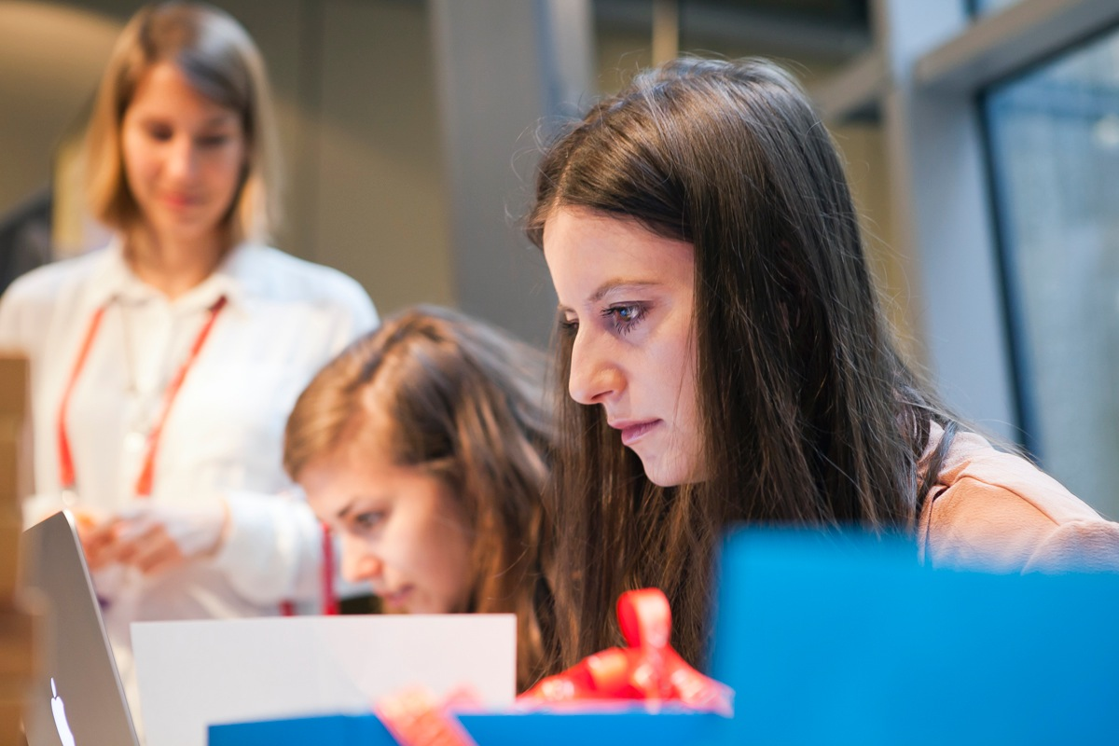
Schedule
21st July 2014
EuroPython, Berlin
8:30 - workshops kick off!
10:30 - 11:30 - break for EuroPython Welcome and breakfast
11:30 - back to code! <3
13:30 - 14:30 - break for PyLadies lunch
14:30 - workshops
16:30 - 17:00 - coffee break
17:00 - 19:00 - more coding!
19:00 - 19:30 - wrap up
20:00 - after party at Prater Bier

Slide 5
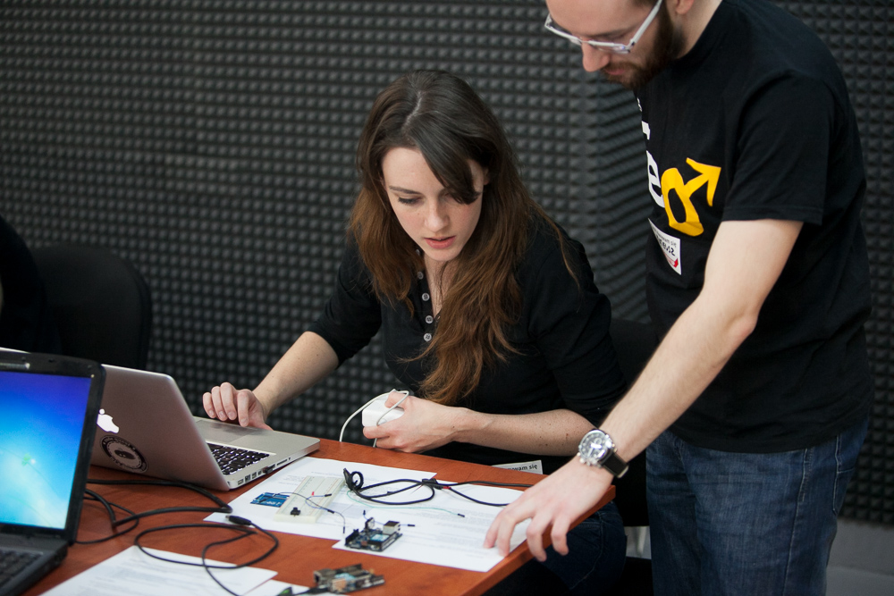
SUPPORT US!
Goals for today:
get excited to make things!
create web application from scratch and put it online
don’t fear errors, bugs and asking questions
meet new people
have fun and be awesome!

Slide 6
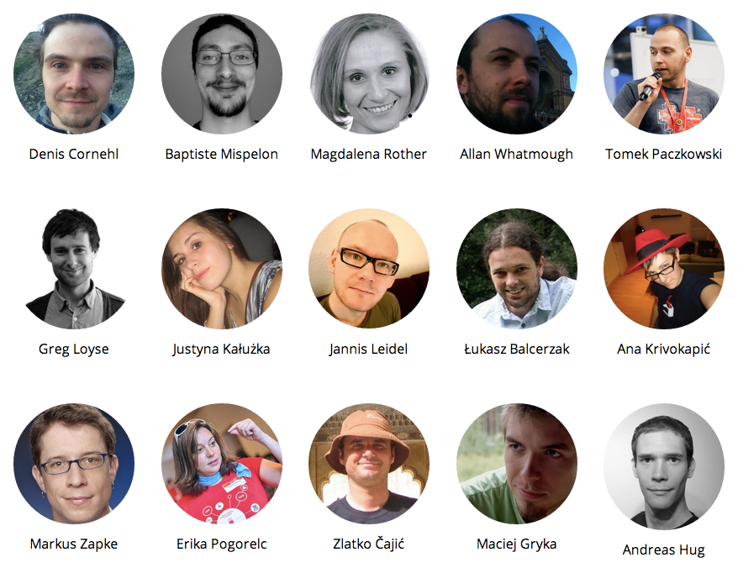

Slide 7

Thank you!

Slide 8
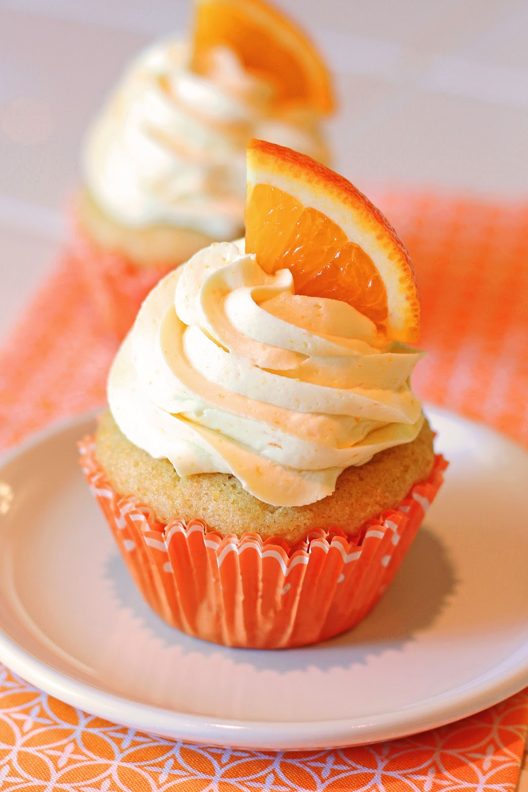
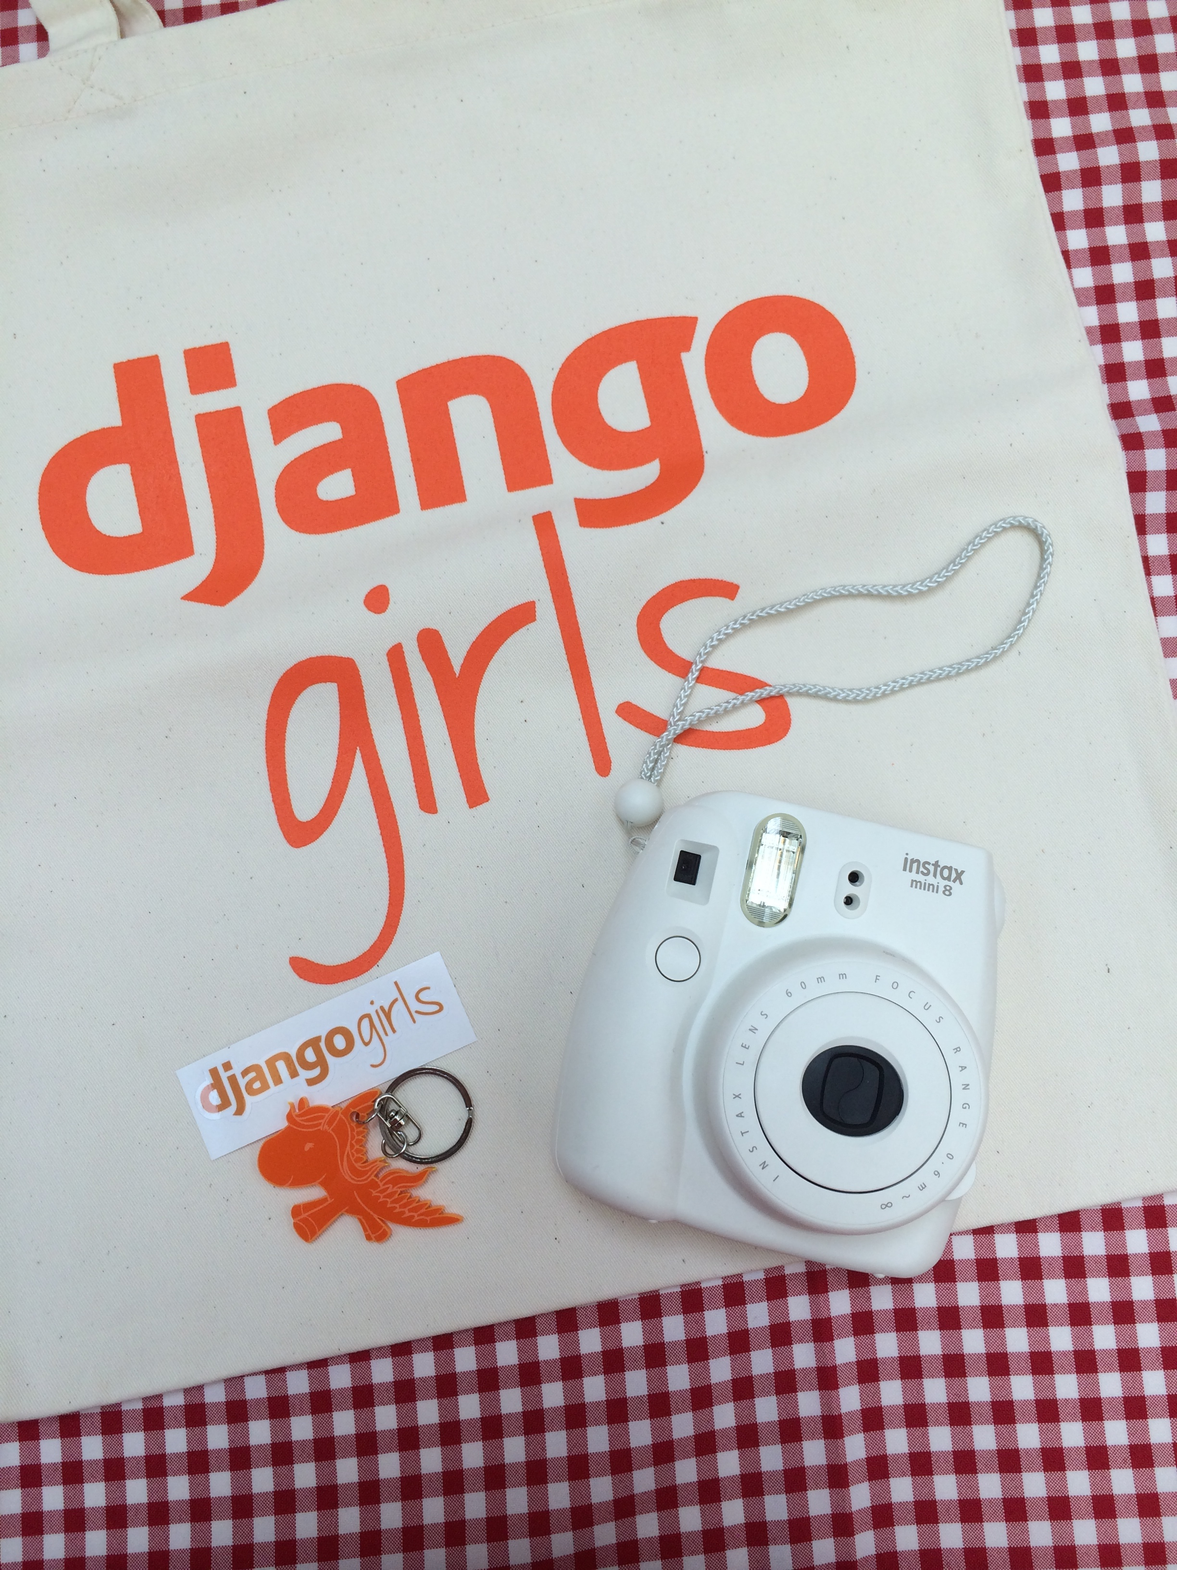

Slide 9
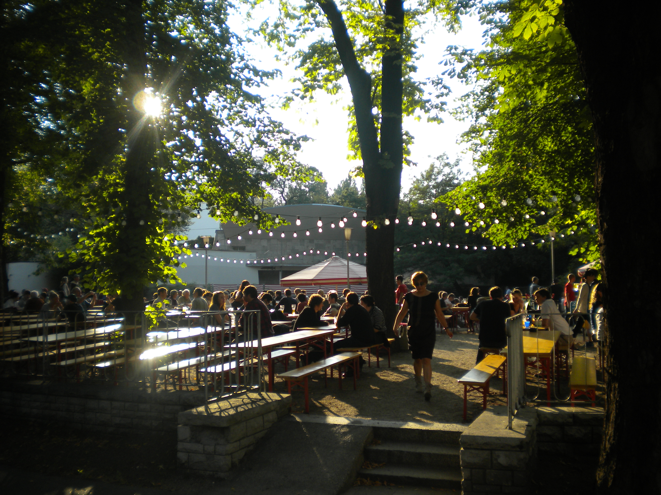
Prater Garten

Slide 10
#djangogirls

Slide 11
Good luck! ♥

Slide 12
http://tutorial.djangogirls.org/

Slide 13
http://tutorial.djangogirls.org/

